Slide 1
SW 프로그래밍
20171105 이민욱

Slide 2
Get FileList
Pattern Search
Ranking
Sorting

Slide 3
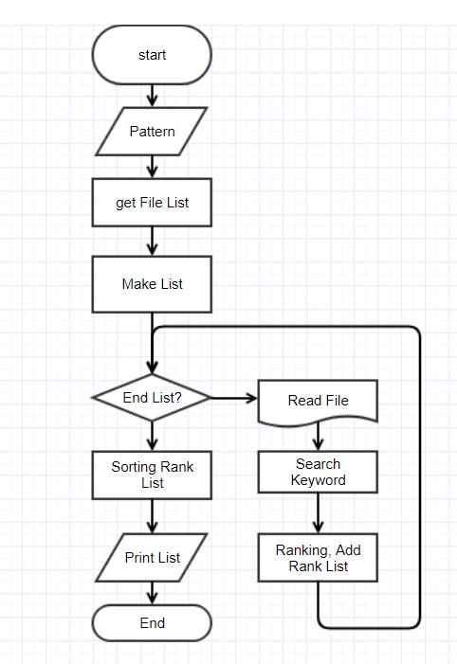
Flow Chart

Slide 4
Get File List
io.h
long _findfirst(char *filespec, struct _findata_at *fileinfo);
int _findnect(long handle, struct _finddata_t *fileinfo);
int _findclose(long handle);

Slide 5
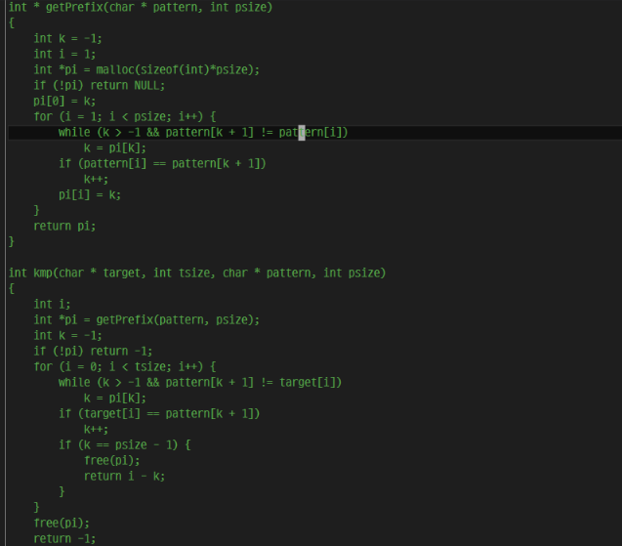

Pattern Search
string.h
const char * strstr ( const char * str1, const char * str2 );
strstr function principle : kmp + $α$
kmp algorithm
Save char* data in LinkedList (because of convenience of ranking)

Slide 6
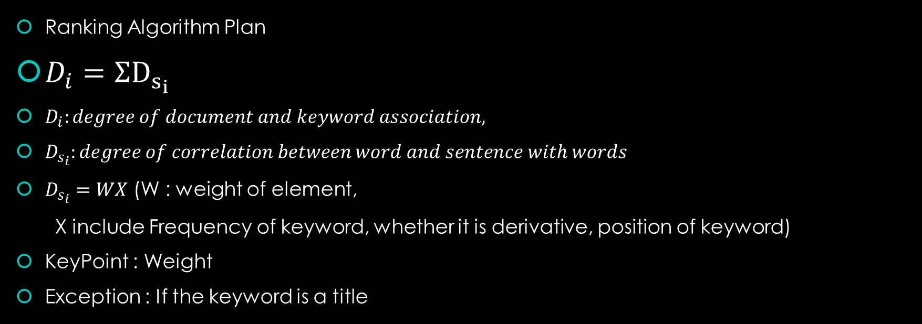
Ranking
Ranking Algorithm Plan
$D_{i}=ΣD_{s_{i}}$
$D_{i}:degree of document and keyword association,$
$D_{s_{i}}:degree of correlation between word and sentence with words$
$D_{s_{i}}=WX$ (W : weight of element,
X include Frequency of keyword, whether it is derivative, position of keyword)
KeyPoint : Weight
Exception : If the keyword is a title

Slide 7
Sorting
Because of Linked List, I use merge sort

Slide 8
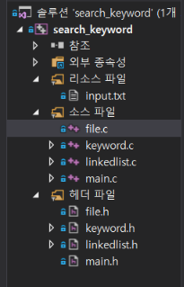
Source & Header File
Linkedlist : LinkedList structure, function
To do : sort list
Keyword : find keyword in document
To do : rank in document
File : Todo : get File list in directory
Main : process argument
As of 10/28

Slide 9
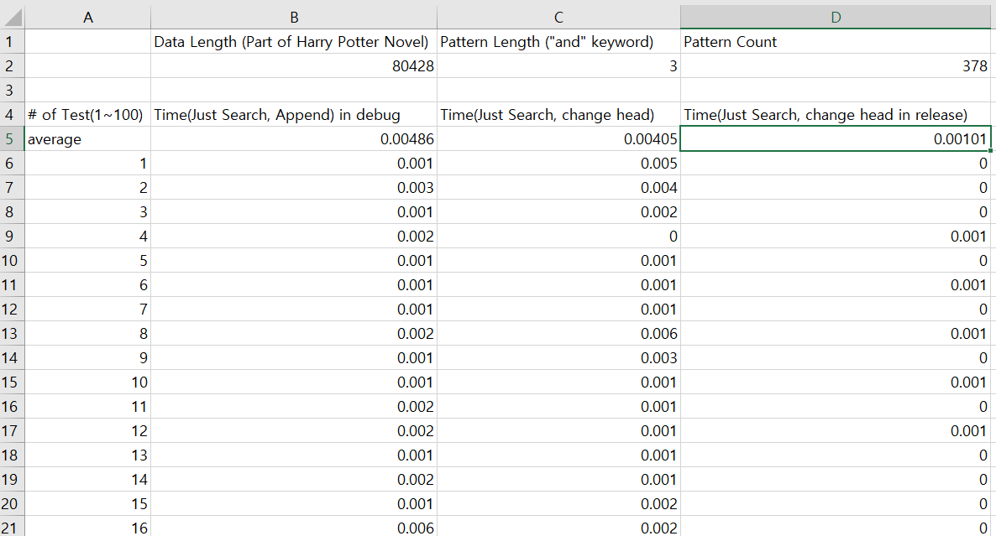
Is it really possible?
Toy Test
The length of time it takes to simply find?
(The decimal precision is up to the fifth decimal place.)

